Slide 1
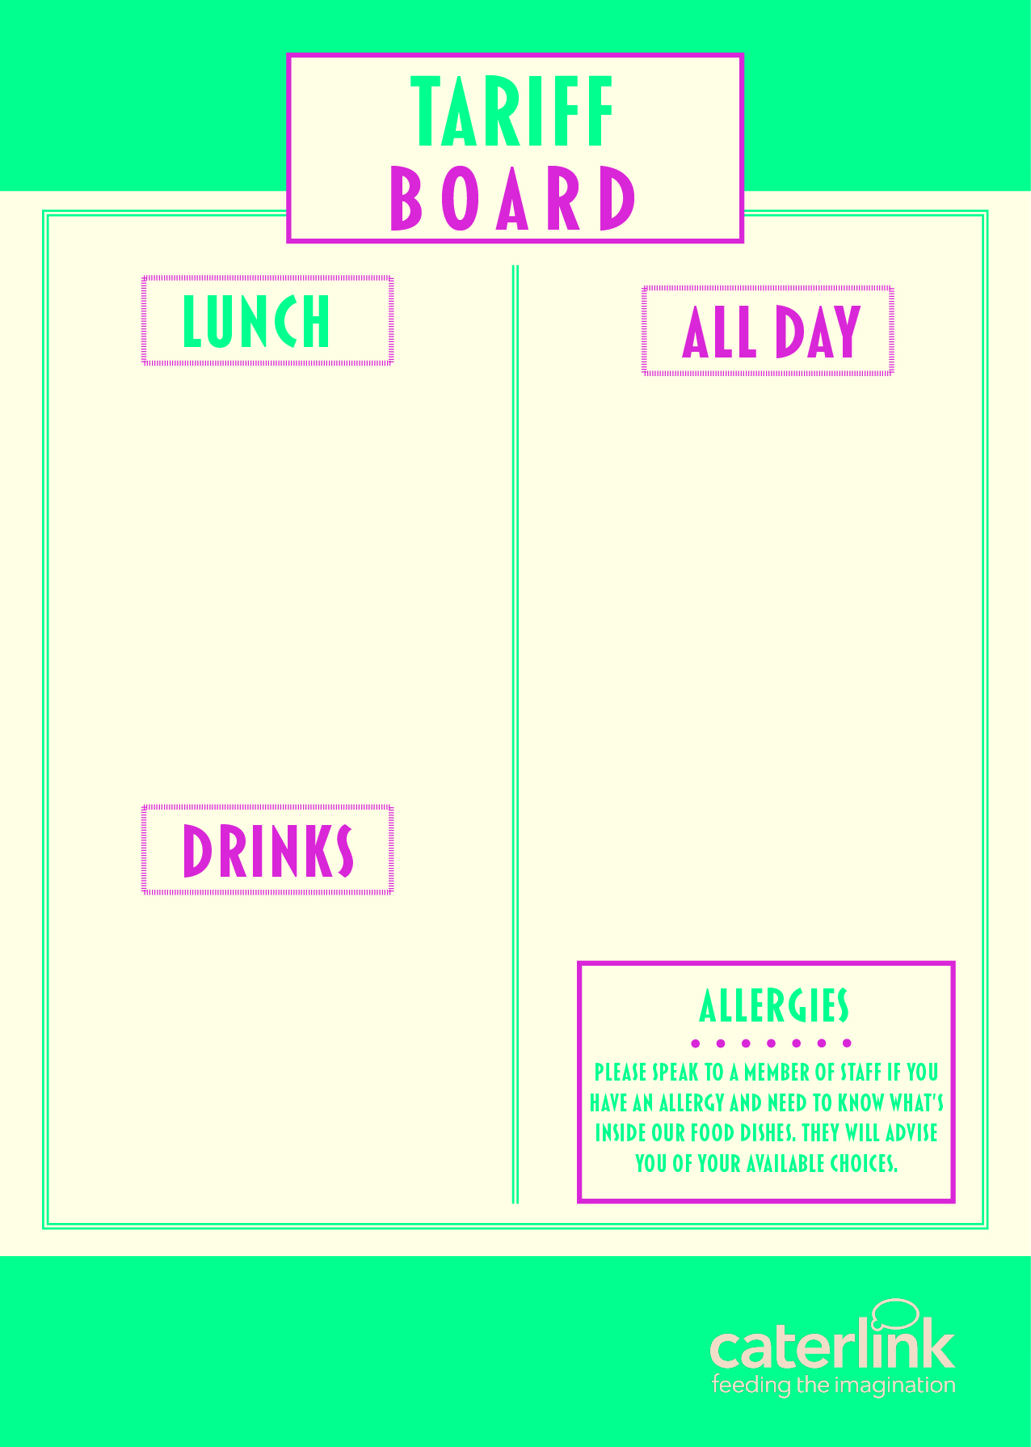
MAIN MEAL (FSM) – HOT | £2.65
MAIN MEAL (FSM) - COLD | £2.65
PIZZA SLICE VEG PIZZA SLICE MEAT | £1.60 £1.70
JACKET POTATO & 1 FILLING | £2.00
PANINI (FROM) | £2.10
HOMEBAKE | £1.15
COOKIE | £1.10
SANDWICHES FROM | £2.00
BAGUETTES FROM | £1.80
WRAPS FROM | £2.00
JELLY POTS | £0.80
FRUIT POTS | £1.10
DESSERT POTS | £1.20
SAUSAGE ROLLS | £1.45
CROISSANT | £1.40
PAIN AU CHOCOLAT | £1.40
WAFFLE | £1.35
BURGER FROM | £2.10
CHICKEN BURGER FROM | £2.25
WATER | £0.90
CAPRI SUN | £1.40
MILKSHAKE | £1.15
RADNOR FIZZ | £1.05
RADNOR LARGE | £1.20
SLUSH | £1.40

