Slide 1
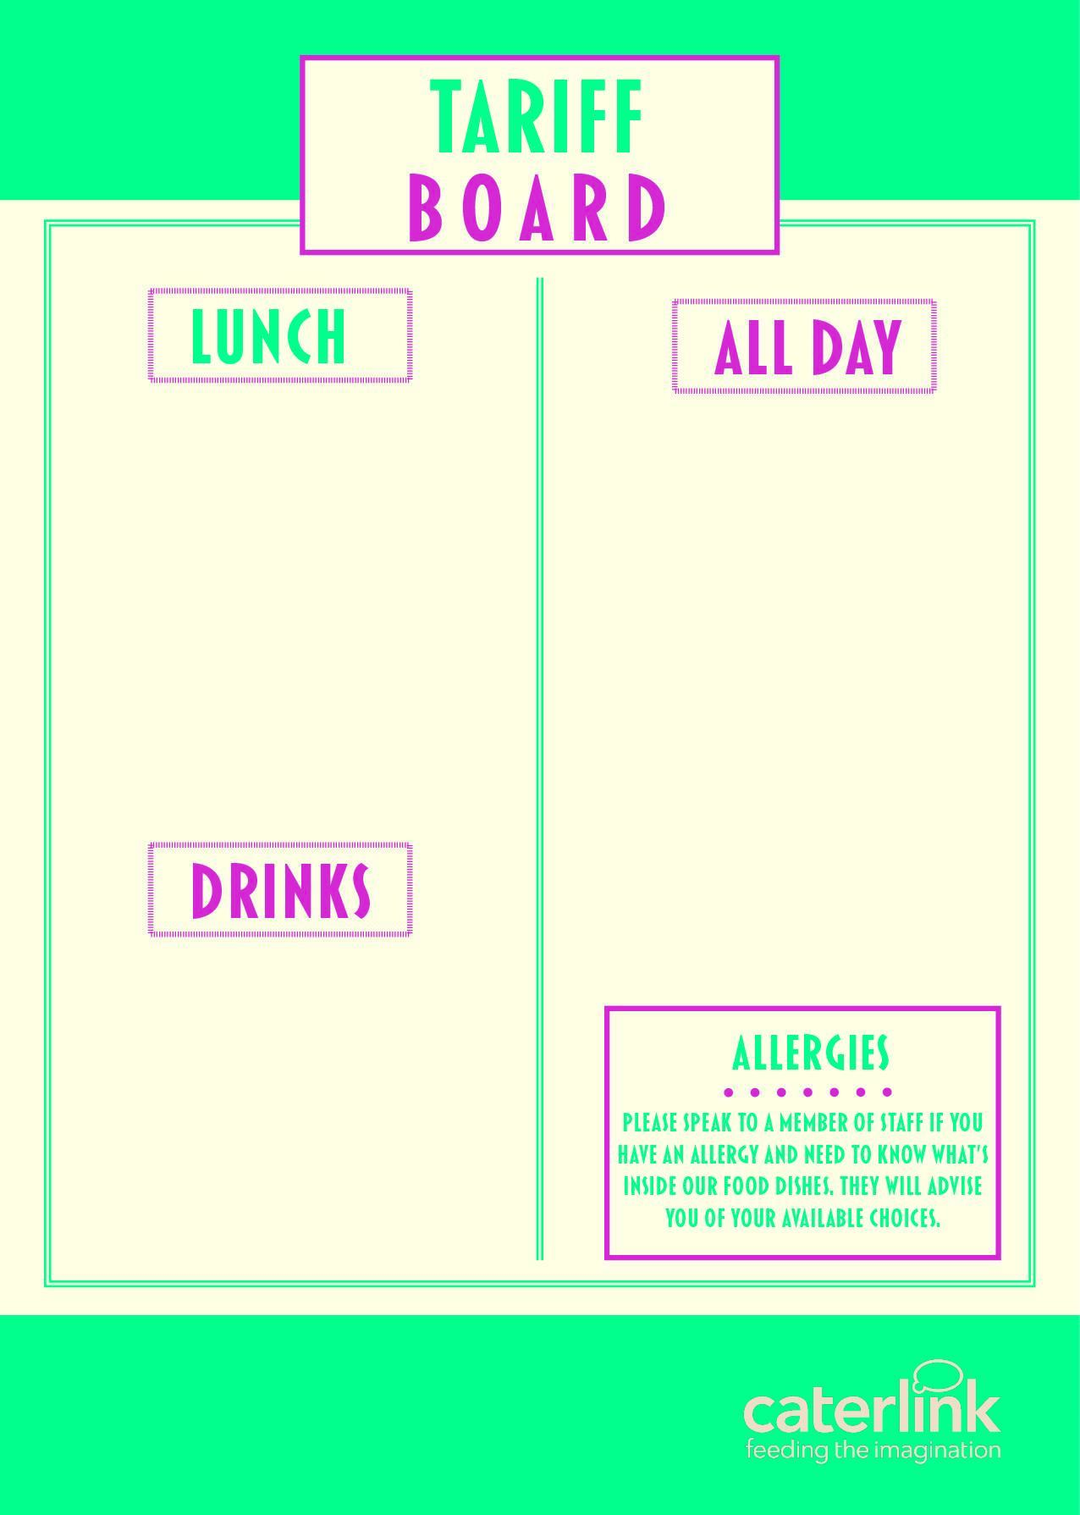
MAIN MEAL (FSM) – HOT | £2.50
MAIN MEAL (FSM) - COLD | £2.50
PIZZA SLICE VEG PIZZA SLICE MEAT | £1.50 £1.60
JACKET POTATO & 1 FILLING | £1.92
PANINI (FROM) | £2.00
HOMEBAKE | £1.00
COOKIE | £1.00
SANDWICHES FROM | £1.80
BAGUETTES FROM | £2.00
WRAPS FROM | £2.00
JELLY POTS | £0.75
FRUIT POTS | £1.10
DESSERT POTS | £1.10
SAUSAGE ROLLS | £1.35
CROISSANT | £1.35
PAIN AU CHOCOLAT | £1.35
WAFFLE | £1.35
BURGER FROM | £2.00
CHICKEN BURGER FROM | £2.20
WATER | £0.90
CAPRI SUN | £1.30
MILKSHAKE | £0.90
RADNOR FIZZ | £0.95
RADNOR LARGE | £1.20
SLUSH | £1.30

